Slide 1
Week 11 Lecture No. 22
Visual Programming C# & .Net Framework
Course Instructor: Dr. Malik Daler Ali Awan
01/10

Slide 2
Topic
Connecting Database
Creating Table
02/10

Slide 3
Database database
How to create database?
Following the steps
Steps
Go to sever Explorer
Click on the Create the relevant Icon
Select the Database option as highlighted in figure
Assign/type the database name
Click create
03/10

Slide 4
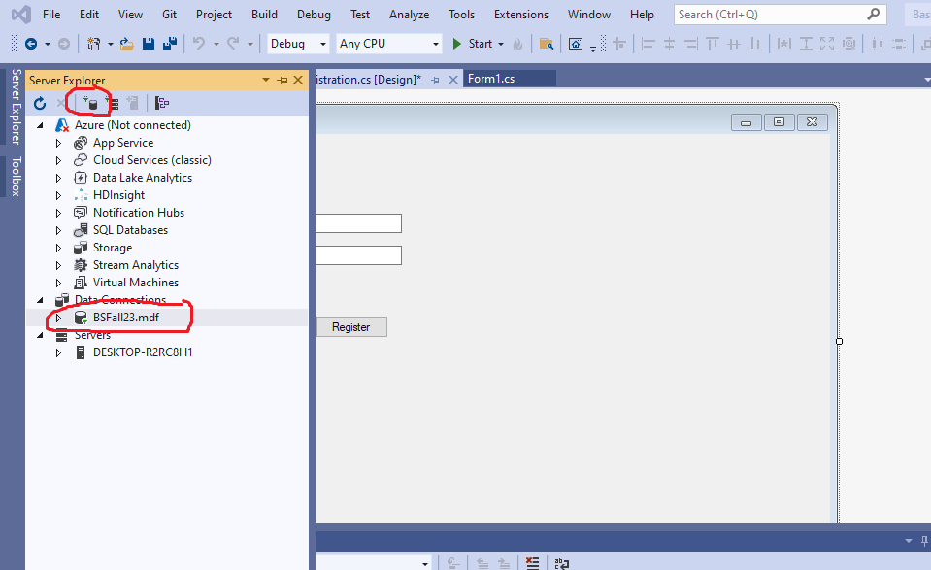
Database Creation (Continue)
04/10

Slide 5
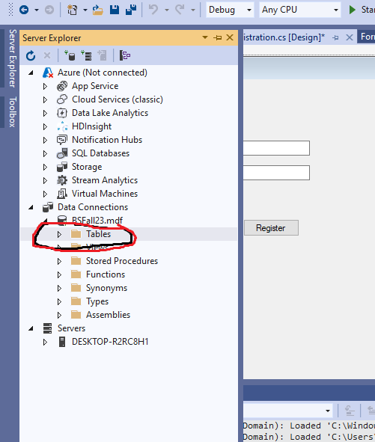
Table
05/10

Slide 6
Table Creation Steps
Right Click on Tables
Chose the create new table
A design view of the table will be appeared
Write the field name and their meta data types
06/10

Slide 7
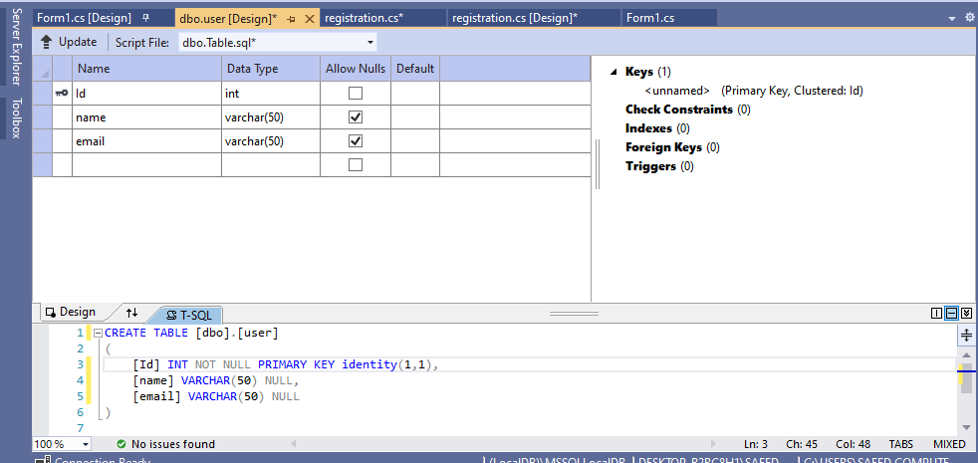
Inserting Field Name in Table
07/10

Slide 8
Table Creation Steps
Use the identity(1,1) to automatically increment the value of primary key
Click on Update icon/UpArrow
Update the Database
08/10

Slide 9
Class Activity
Create more fields in table.
09/10

Slide 10
Thank you!
10/10

